Slide 1
Responsible Research Evaluation & Impact Assessments
Paul Wouters
AESIS 2021
Spring Course Impact Strategies
Notes:
[Onszelf voorstellen]

Slide 2
Responsible evaluation

Slide 3


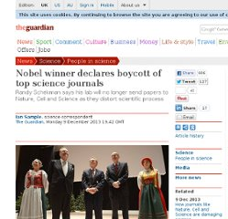
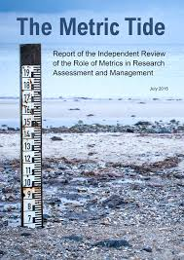
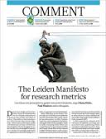


Slide 4
The Leiden Manifesto
Quantitative evaluation should support expert assessment.
Measure performance in accordance with the research mission.
Protect excellence in locally relevant research
Keep data collection and analytical processes open, transparent and simple.
Allow for data verification
Account for variation by field in publication and citation practices
Data should be interpreted taking into account the difficulty of credit assignment in the case of multi-authored publications.
Base assessment of individual researchers on qualitative judgment.
False precision should be avoided (eg. the JIF).
Systemic effects of the assessment and the indicators should be taken into account and indicators should be updated regularly
Diana Hicks (Georgia Tech), Paul Wouters (CWTS), Ismael Rafols (SPRU/Ingenio), Sarah de Rijcke and Ludo Waltman (CWTS) (2015) Nature 520: 429–31. doi:10.1038/520429a

Slide 5

Responsible metrics
Responsible metrics can be understood in terms of:
Robustness: basing metrics on the best possible data in terms of accuracy and scope;
Humility: recognizing that quantitative evaluation should support – but not supplant – qualitative, expert assessment;
Transparency: keeping data collection and analytical processes open and transparent, so that those being evaluated can test and verify the results;
Diversity: accounting for variation by field, using a variety of indicators to reflect and support a plurality of research & researcher career paths;
Reflexivity: recognizing the potential & systemic effects of indicators and updating them in response.

Slide 6
Measuring is changing
What counts as quality is shaped by how we measure and define “quality”
What counts as impact is shaped by how we measure and define “impact”
Qualities and interactions are the foundation for “excellence” and “impact” so we should understand those more fundamental processes first
We need different indicators at different levels in the scientific system to inform wise management that strikes the right balance between trust and control
Context is crucial for effective data standardization

Slide 7
Context counts
Responsible metrics is not supposed to be a universal standard
Responsible metrics should be responsive and inclusive metrics
The context shapes what responsible metrics means:
  the urgency of social problems (poverty, inequality, unemployment and corruption)
  local research and educational missions
  the local appropriation of “the global”
  the values embedded in the policies and communities

Slide 8
Break out session I

Slide 9
Break out session I
Does responsible evaluation figure in your impact evaluation strategies at national level?
What counts as responsible evaluation in your country?
And how is this implemented at the level of the research organization?

Slide 10
New approaches in evaluation

Slide 11
Recommendations on measuring impact at AESIS 2017
Develop new evaluative methodologies to both enable and make visible societal impact of scholarship and research as well as interactions between researchers and society
Re-orient academic assessment systems towards incentives for interaction with society; end assessments that basically promote academic arrogance and insularity
Combine quantitative with qualitative evidence of impact and always put the evidence in context (keep in mind: Measuring is Changing and Context Counts)

Slide 12
Break Out Session II

Slide 13
How to measure impact
How would you prefer to measure impact?
What is the most important type of impact?
How would you balance monitoring versus stimulating research impact?

Slide 14
Impact as performance

Slide 15
Quality/impact are produced by assessment practices and structures
What counts as excellence is shaped by how “excellence” is measured and defined
What counts as impact is shaped by how “impact” is measured and defined
Qualities and interactions are the input for “excellence” and “impact” but the context of assessment is as important in shaping what counts as quality and impact
Indicators are the semiotic vehicles that translate between “daily life of a researcher” and “science policy” at the level of the research organization

Slide 16
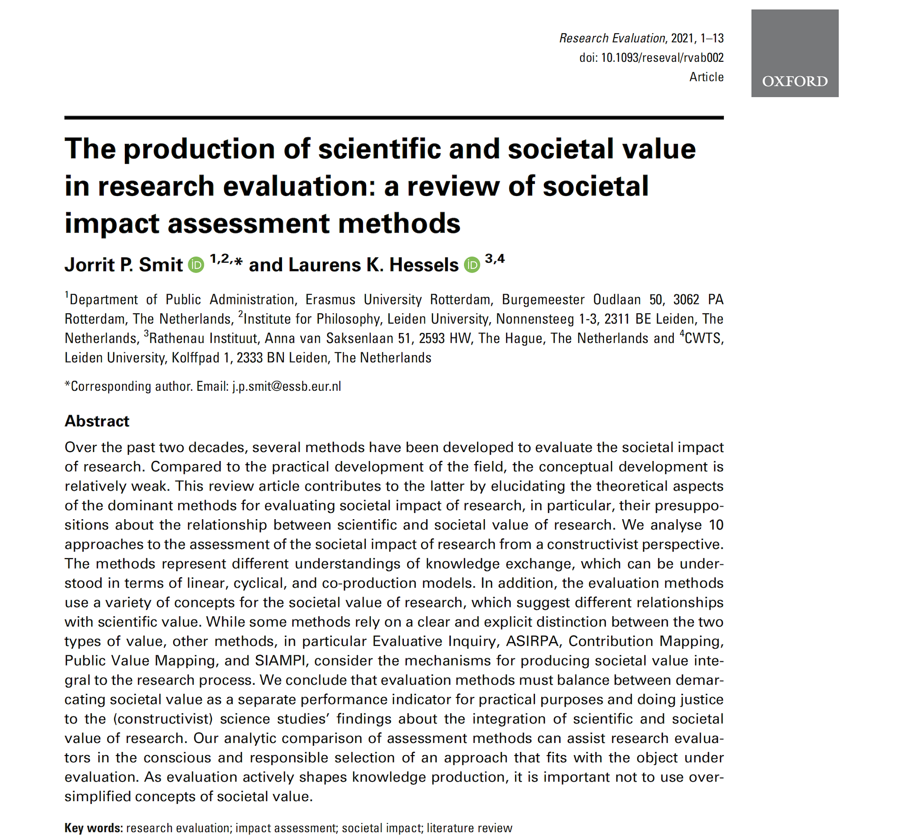
Review impact measurement methods

Slide 17
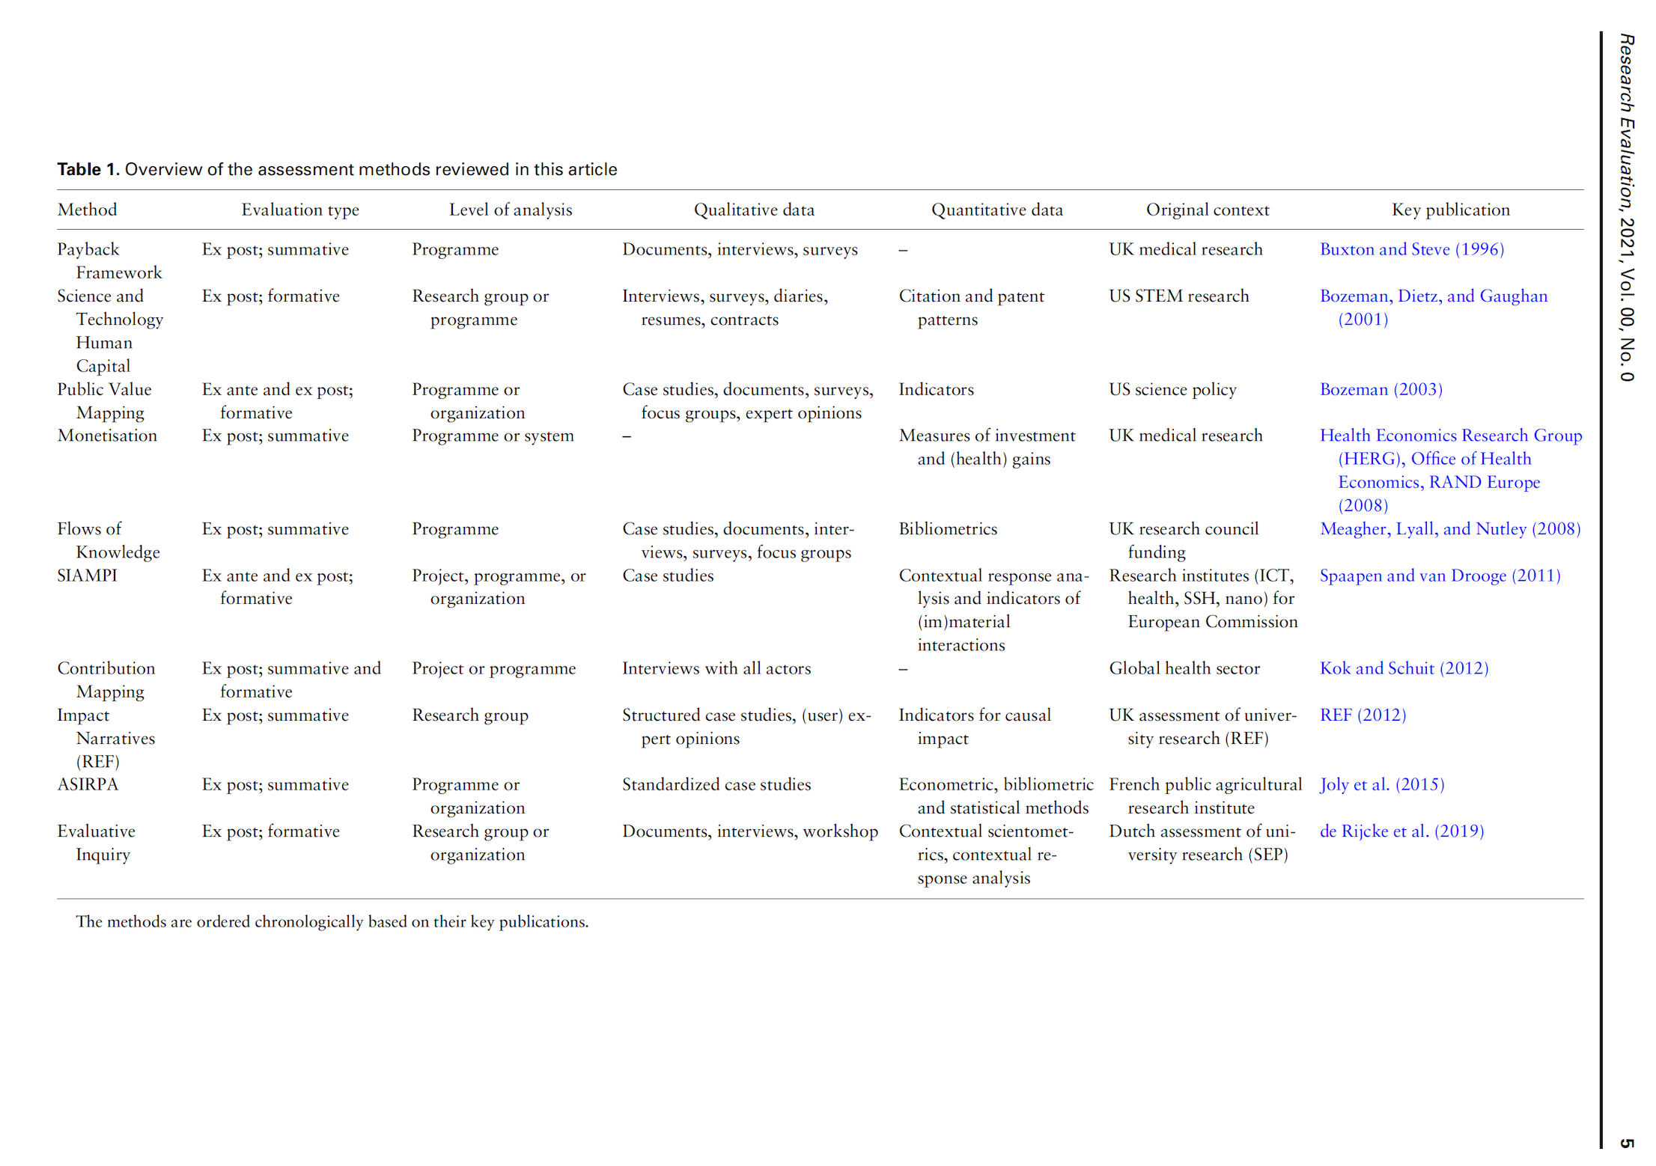

Slide 18
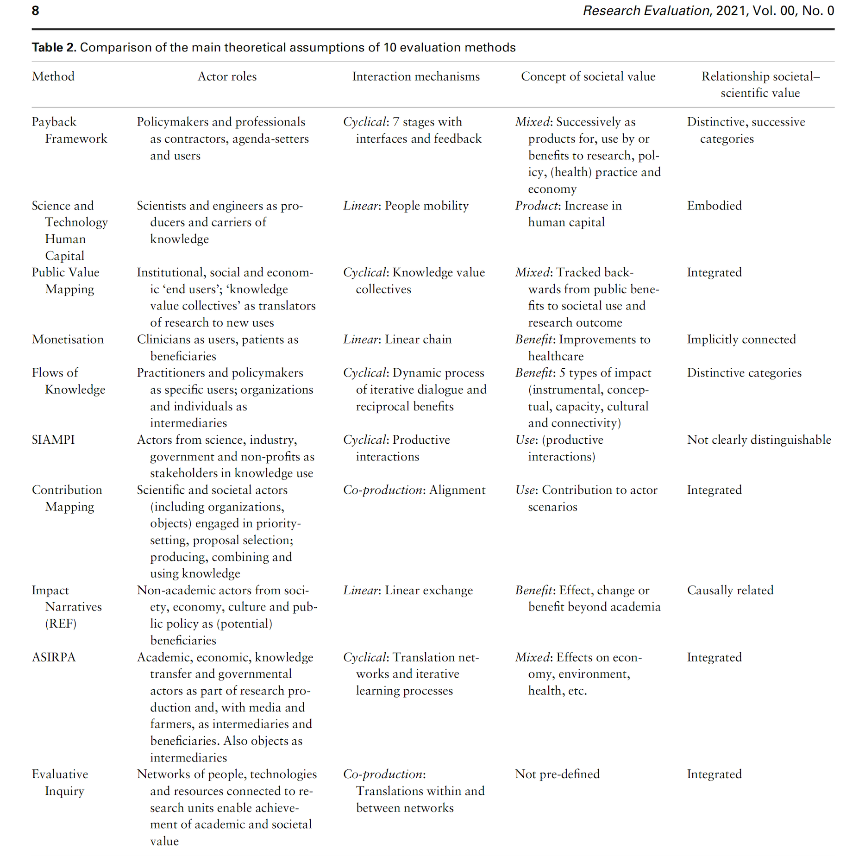

Slide 19
Evaluative Inquiry
Rethinking research excellence and academic quality.
Research quality is not just an academic issue, but relevant to policy, professional networks and societal domains.
Metric analyses offer limited understanding of reality. A portfolio of different methodologies offers additional perspectives.
Evaluations are often used as accountability tools. As such they don’t enable organizational learning. The evaluative inquiry aspires to both.

Slide 20
The Evaluative Inquiry’s method
1. Exploration | What are the central issues and questions of the project? Document analysis and conversations with client.
 | Design of research approach and specification of combination of methods.
2. Data collection and analysis | # Contextual Response Analysis (Prins, n.d.); contextual scientometrics (Waltman & van Eck, 2016); bibliographic coupling; co-citation analyses; Area Based Connectedness (Noyons, 2018) # Interviews with researchers and stakeholders about institutional organization, academic themes, output and impact.
 | Workshops – data collection for SWOT analysis and/or testing of hypotheses.
3. Reporting | Analysis of institutional organization as well as the relations between academic themes, output and impact. SWOT. Suggestions for self-assessment.

Slide 21
PThU data collection and analysis
Contextual Response Analysis: (online) analysis of users of research results to establish which (potentially unknown) users are being reached.
Interviews with employees and stakeholders about the institutional organization and impact pathways: connections between themes and ambitions; mobilization of people and resources; outputs; impact on societal, academic and professional domain.
Workshop to test hypotheses and collect material for SWOT.

Slide 22
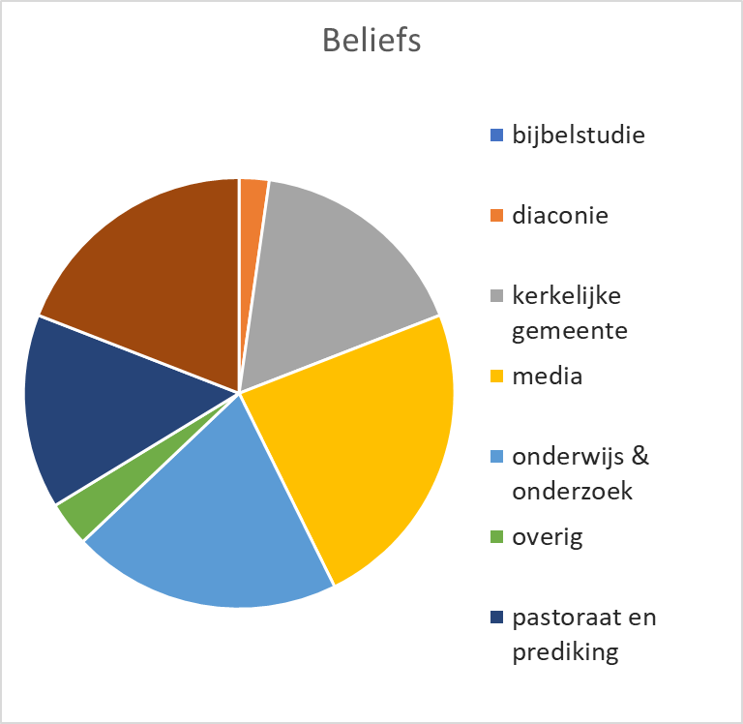
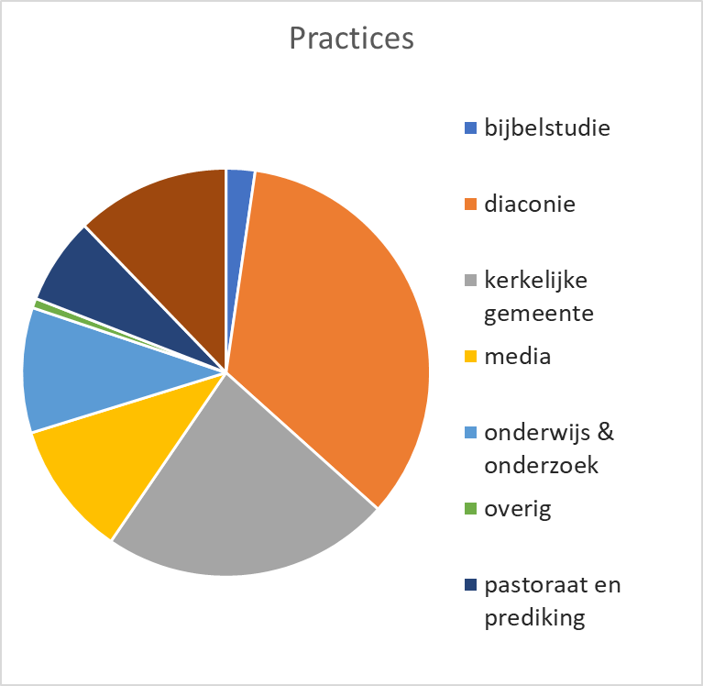
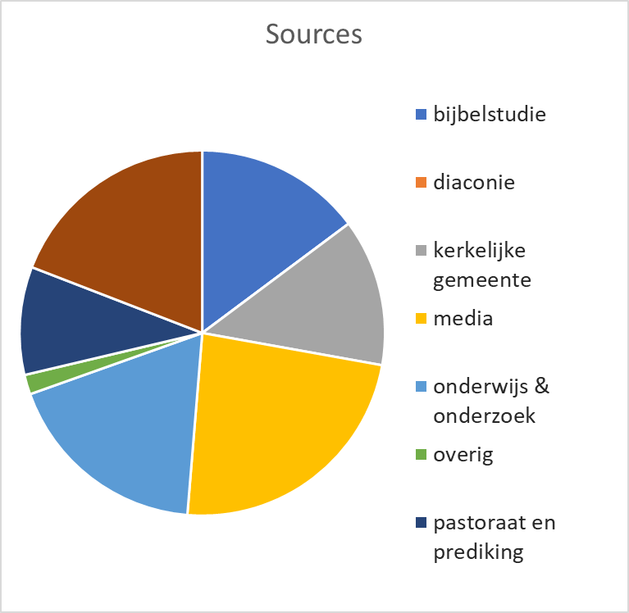
CRA analysis: different profiles…
Research teams have distinct profiles

Slide 23
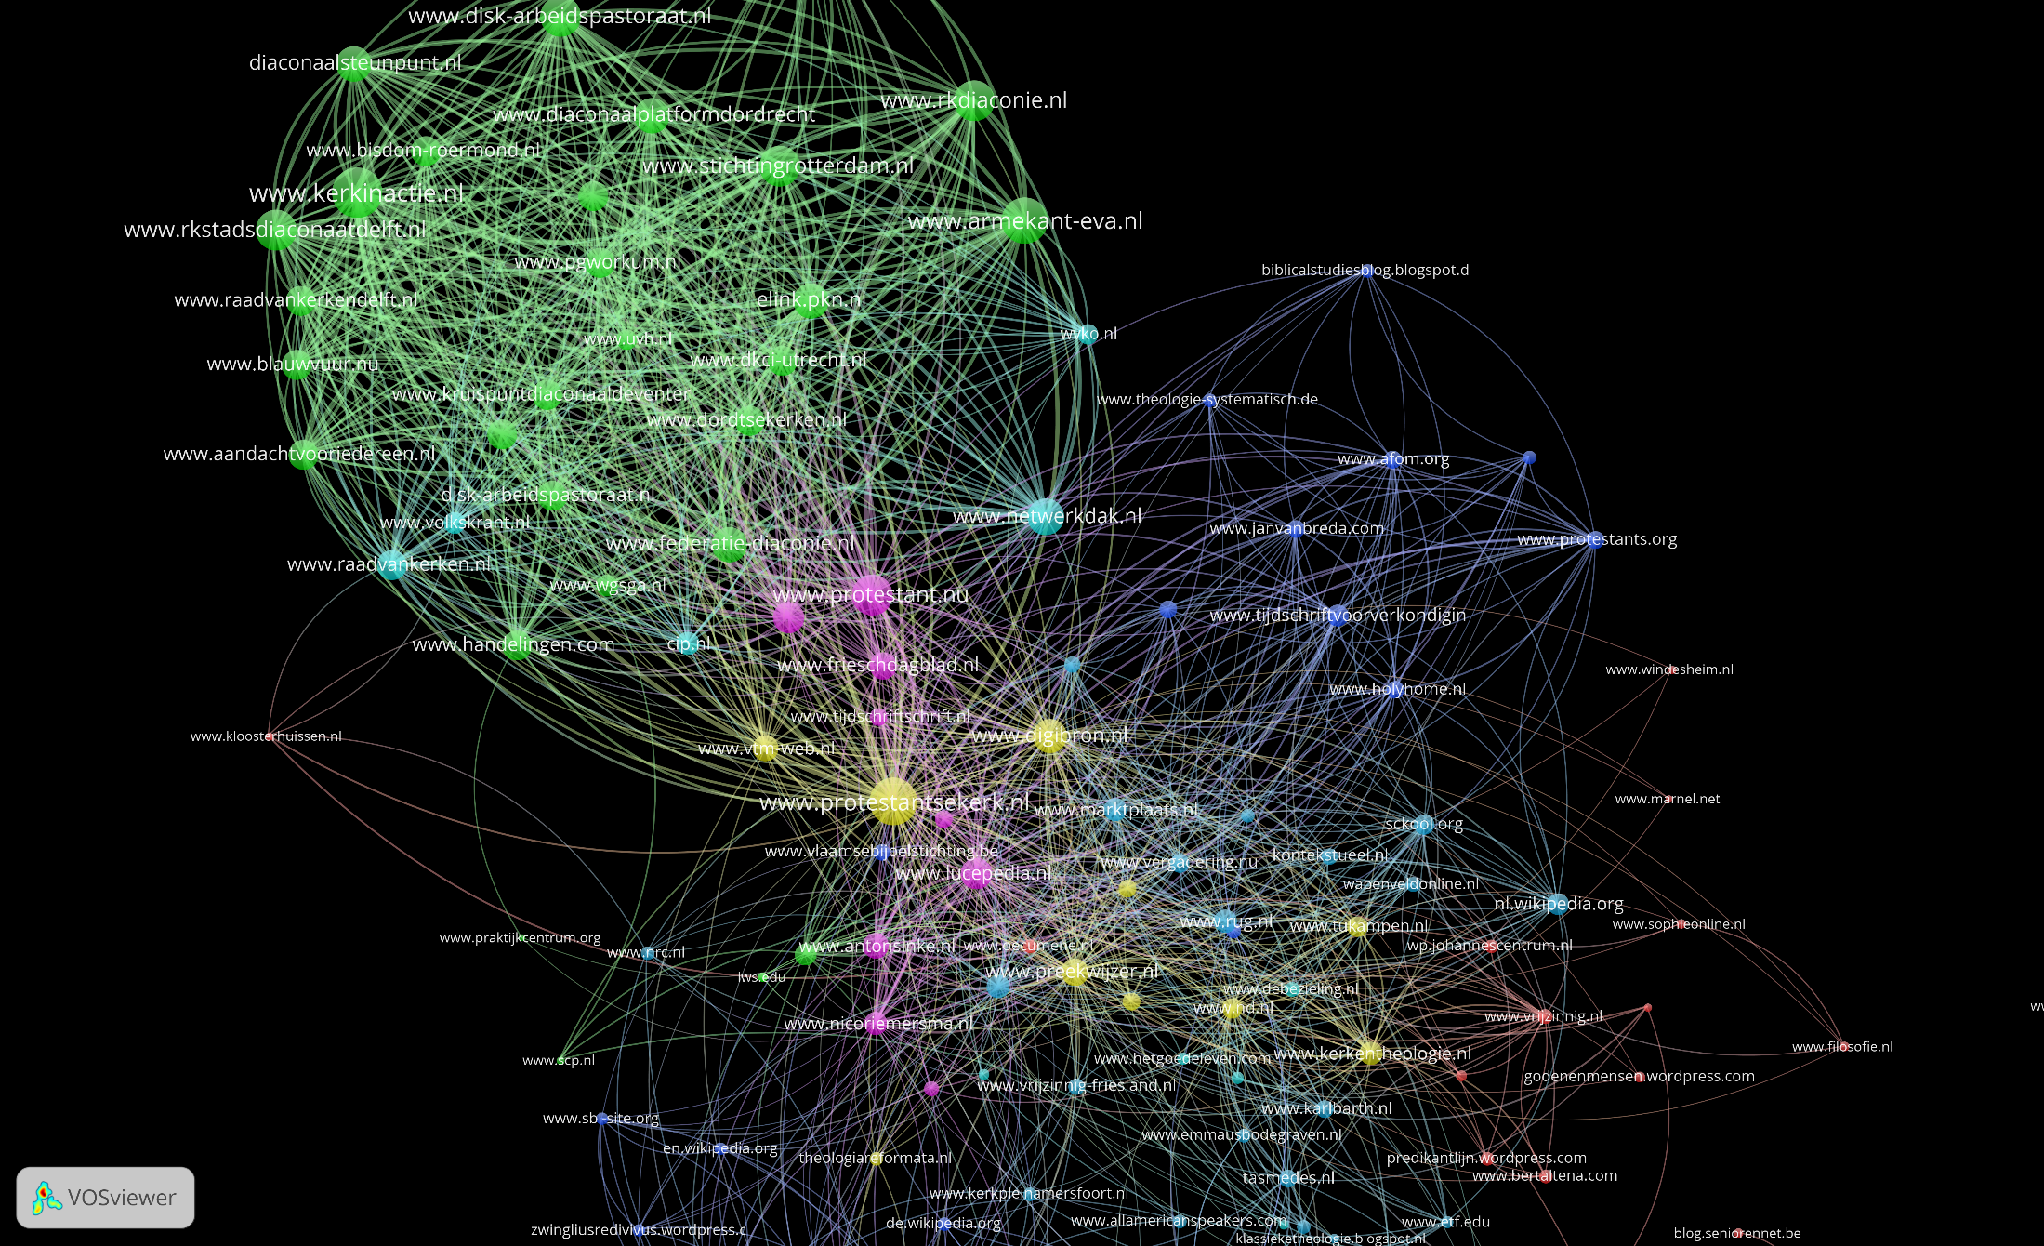
And affinities
PThU staff connected in co-citation map

Slide 24
Results evaluative inquiry
Detailed analysis of:
  Evolution and transformation of research topics
  Possibility to diversify and protect local excellence
    Translation knowledge in outputs, outcomes, impacts
    Distinction between different phases of generating impact (scientific, societal)
  Involved networks of actors and types of resources
  Influence research on academic and societal networks and fields

Slide 25
Characteristics
  tailor made and modular
  content oriented, learning capacity central
  mixed methods approach
  Indicators as ‘proxies’ for narratives
Makes visible:
  mission and research topics
  communication and collaboration patterns
  all types of output and results
  conditions for research and infrastructure
  process determinants (eg open science, gender diversity)

Slide 26
What can you do with it
Can serve as a starting point to develop or refine the missions of the organization
Based on the views and experiences of researchers and users (bottom up)
Articulating what is already going on
And identifying new possibilities
    New audiences, existing ones
    Ways of communication next to books and articles
    A clearer structure of the organization, in terms of programs, centres and projects

Slide 27
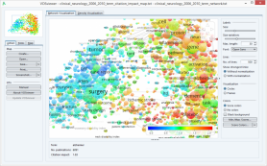
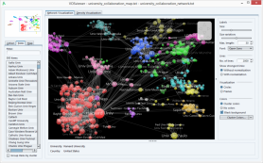
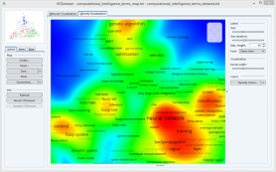
Map interactions rather than output
Innovation interactions take place in heterogeous networks of actors
Science is “applied” in translation processes: science is not immediately useful
Mapping impact means mapping these interaction processes rather than isolated impact results

Slide 29

portfolio
aim is to give researchers a voice in evaluation
evidence based arguments
shift to dialog orientation
selection of indicators
narrative component
Good Evaluation Practices
envisioned as web service
expertise
output
narrative
influence

Slide 30
ACUMEN Portfolio
Career Narrative
Links expertise, output, and influence together in an evidence-based argument; included content is negotiated with evaluator and tailored to the particular evaluation
Evaluation Guidelines
aimed at both researchers and evaluators
development of evidence based arguments (what counts as evidence?)
expanded list of research output
establishing provenance
taxonomy of indicators: bibliometric, webometric, altmetric
guidance on use of indicators
contextual considerations, such as: stage of career, discipline, and country of residence
Expertise
- scientific/scholarly
- technological
- communication
- organizational
- knowledge transfer
- educational
Output
- publications
- public media
- teaching
- web/social media
- data sets
- software/tools
- infrastructure
- grant proposals
Influence
- on science
- on society
- on economy
- on teaching

Slide 31
Portfolio & Guidelines
Instrument for empowering researchers in the processes of evaluation
Taking in to consideration all academic disciplines
Suitable for other uses (e.g. career planning)
Able to integrate into different evaluation systems

Slide 32
Context Response Analysis (CRA)
Tracing use, classifying the user in society, science, news and politics
  Goal: Enabling evaluation in terms of learning from past performance
  Developed in concurrence with SIAMPI, ERiC
  Method: formalized searches in Parliament, LexisNexis, Google & Bing, GS
  Result: profiles of research units, identified stakeholders
Flexibility
  Operationalize the method to address issues and questions in the evaluation
  Identifying meaningful interactions or groups of stakeholders

Slide 33
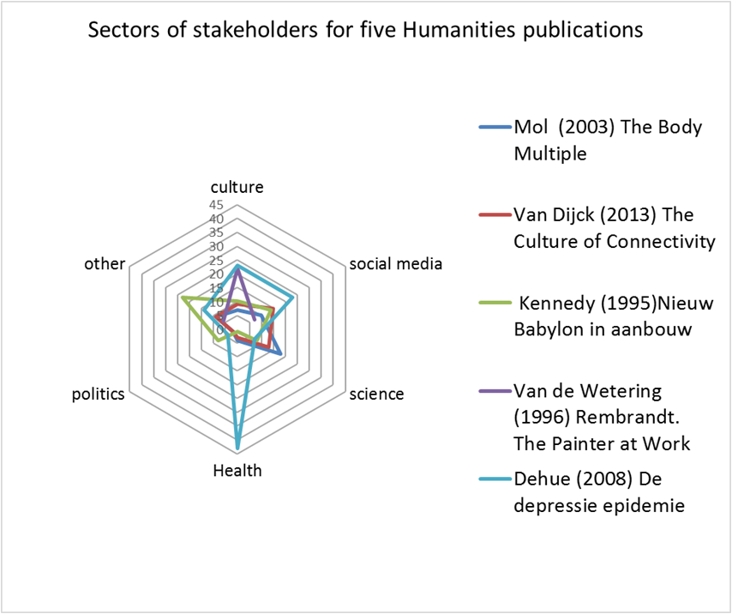
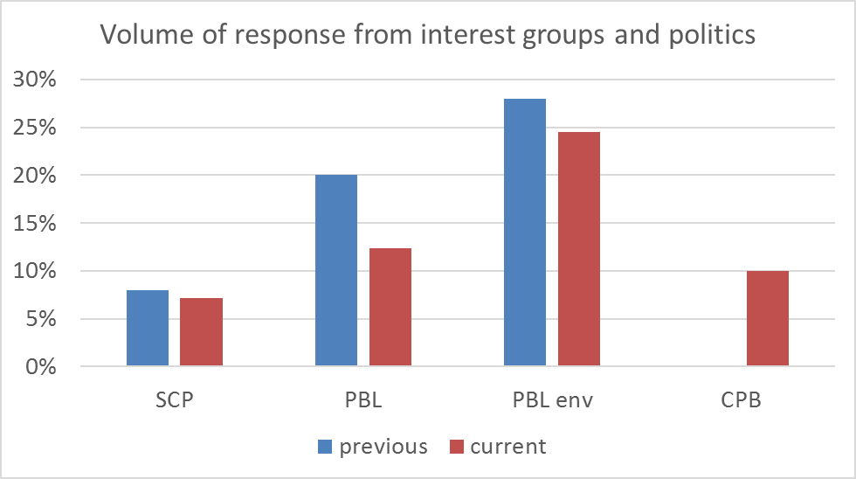
CRA types of outcome
Hybrid outcomes of research: combined academic and societal interest

Slide 34
Next steps in management and policy
Remove performance indicators that are no longer contributing to the mission
Do not artificially isolate “impact” from “quality”
Embrace variety rather than give in to policy push for “one approach”
Develop experiments with interactive evaluation exercises with researchers and stakeholders
Map interactions rather than measure impact

Slide 35
Thank you for your attention

